Slide 1

FY 2023-24 One Year Action Plan
City of West Palm Beach
Department of Housing & Community Development
May 10, 2023

Slide 2
Agenda
Consolidated Planning Process & Overview of HUD Programs
FY 2021-2022 Accomplishments and Current Projects
FY 2023-2024 Proposed Action Plan Activities
Other HCD Happenings
Comments from the Public

Slide 3
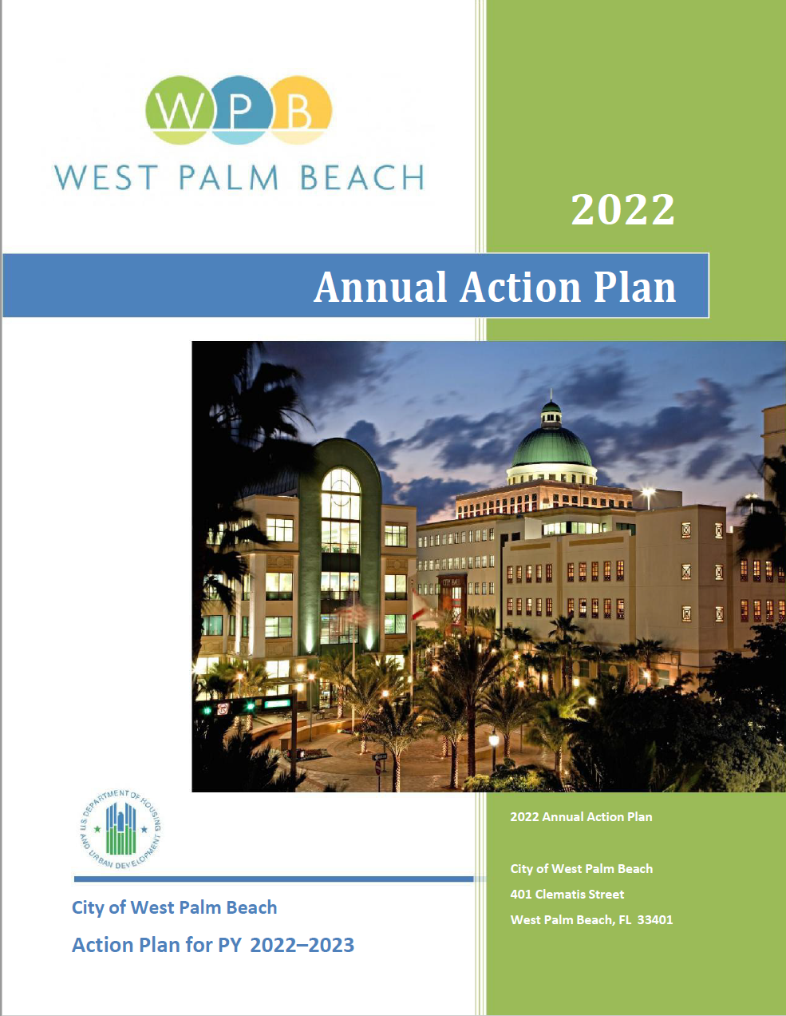
Consolidated Planning Process
A Consolidated Plan (24 CFR Part 91) is the 5-year plan submitted to the U.S. Department of Housing and Urban Development (HUD) that serves as the comprehensive housing affordability strategy, community development plan, and submission for funding under the following federal formula grant programs:
Community Development Block Grant (CDBG) Program
HOME Investments Partnership Program (HOME)
Housing Opportunities for Persons with AIDS (HOPWA) Program
The Consolidated Plan is carried out through an annual Action Plan which provides a concise summary of the activities, projects, and specific federal and non-federal resources that will be used each year.
This plan covers the activities that will be undertaken during the FY 2023 program year October 1, 2023 – September 30, 2024.

Slide 4
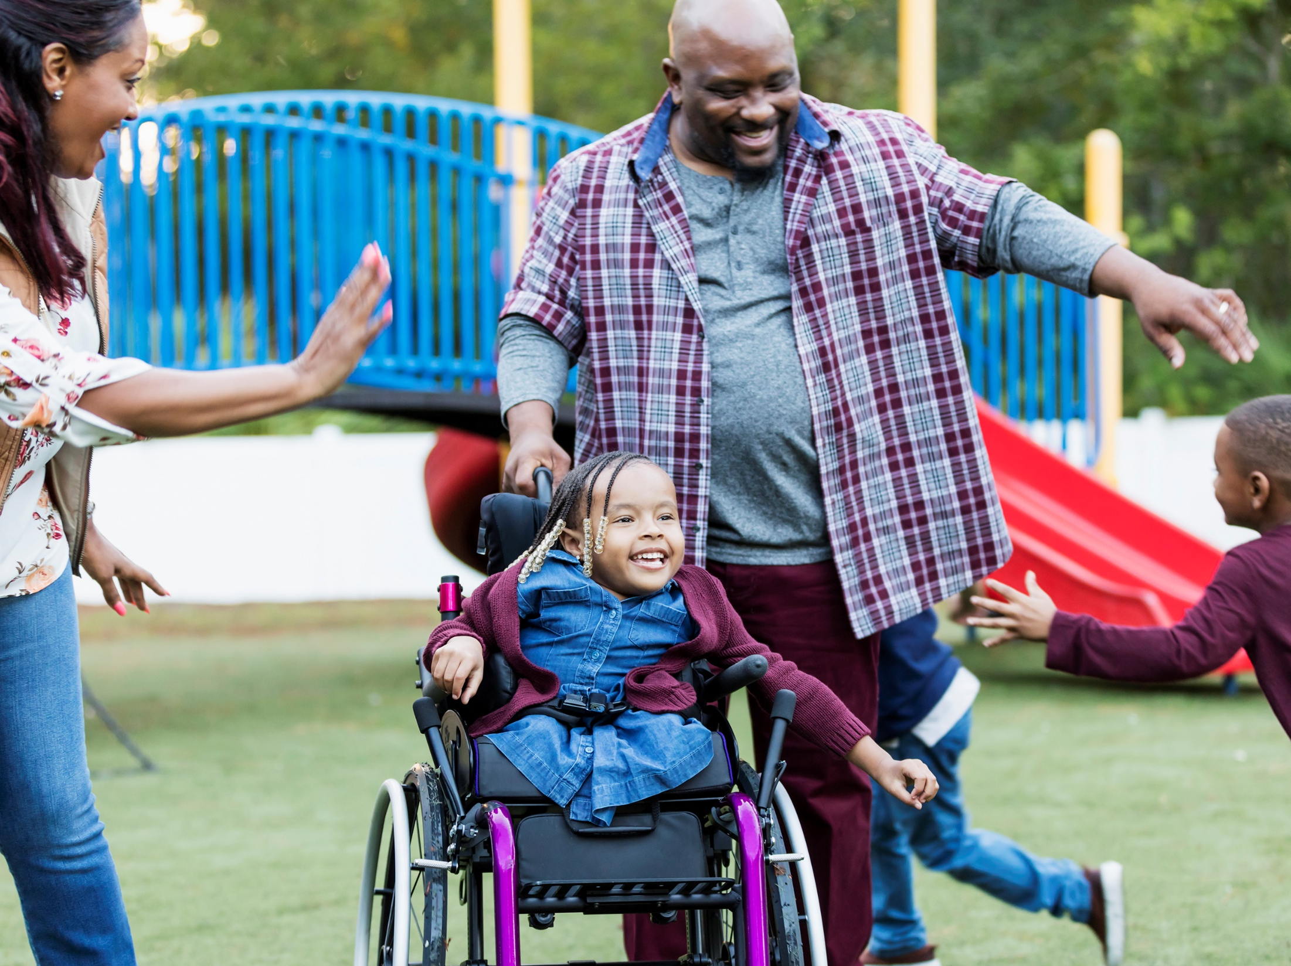
FY 2021/22 Accomplishments

Slide 5
Summary of Annual Performance Report
FY 21-22 Goals/Objectives
  Affordable Housing
  Homelessness Assistance and Public Services
  Public Facilities and Infrastructure
Resources and Investments
Program | Resources Made Available | Expenditures during FY 2021-22*
CDBG | $1,023,448 | $2,013,111
CDBG-CV | $1,024,024 | $99,209
HOME | $478,968 | $64,896
HOPWA | $3,202,608 | $2,995,337
HOPWA-CV | $447,166 | $300,805
TOTAL | $6,176,214 | $5,473,358
* Includes expenditures of funds from prior year resources and/or program income

Slide 6
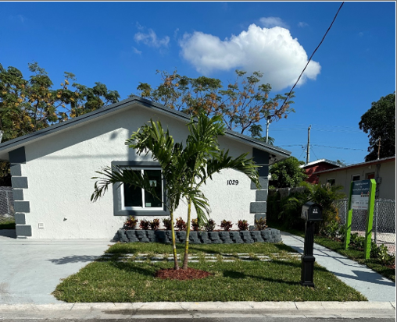
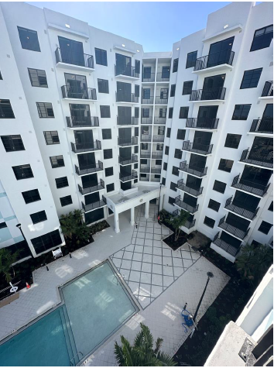
Housing Accomplishments
Rental assistance and supportive services to 226 extremely low, very low, and low-income, special-needs households (HOPWA)
Permanent housing placement, rent/mortgage and utility assistance, and hotel/motel leasing for 45 individuals (HOPWA-CV)
Rental projects underway
Flagler Station: 94 units (HTF)
The Grand: 206 WFH units
(309 units total)( (HTF/CRA)
Homeownership projects underway
Construction of 5 affordable single-family housing units (SHIP)

Slide 7
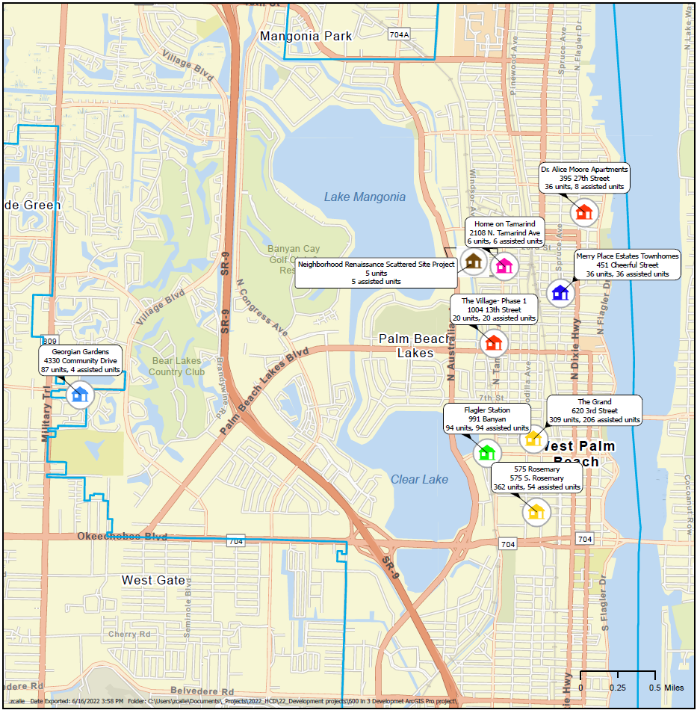
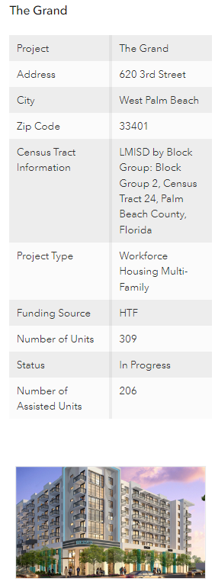

600-in-3 Initiative
Various Funding Sources including:
  HOME
  SHIP
  Local HTF
  LIHTC
  Developer Incentives

Slide 8
Homelessness/Public Service Accomplishments
Vickers House/ HCD Community Services Division as of the end of calendar year 2021:
  118 individuals experiencing chronic homelessness were connected to housing.
  51 individuals experiencing chronic homelessness were reconnected with a loved one or family member.
  339 individuals were provided with referrals and access to mental health and substance abuse resources.
  96 local businesses and community groups were provided education and resources.
  348 requests for assistance were submitted and addressed through the City’s online Homeless Activity Reporter (HAR).
  2,393 engagements were conducted through city parks, neighborhoods and targeted areas.

Slide 9
Homelessness/Public Service Accomplishments
Partnered with Mental Health America to provide services to support outreach and homeless prevention efforts (CDBG)
  Benefitted 24 persons
Serving our Seniors programs emergency grants for elderly residents used for utility assistance (CDBG)
  Benefitted 6 households
Housing Stabilization Program provides rent, mortgage, utility assistance (SHIP)
  Benefitted 6 households

Slide 10
Homelessness/Public Service Accomplishments
Supported the Esperanza Center Outreach Program provides COVID-19 related health services, PPE, and education (CDBG-CV)
  Benefitted 310 persons
FAU Nursing Community Health Center at U.B. Kinsey (CDBG-CV)
  Benefitted 1,399 persons

Slide 11
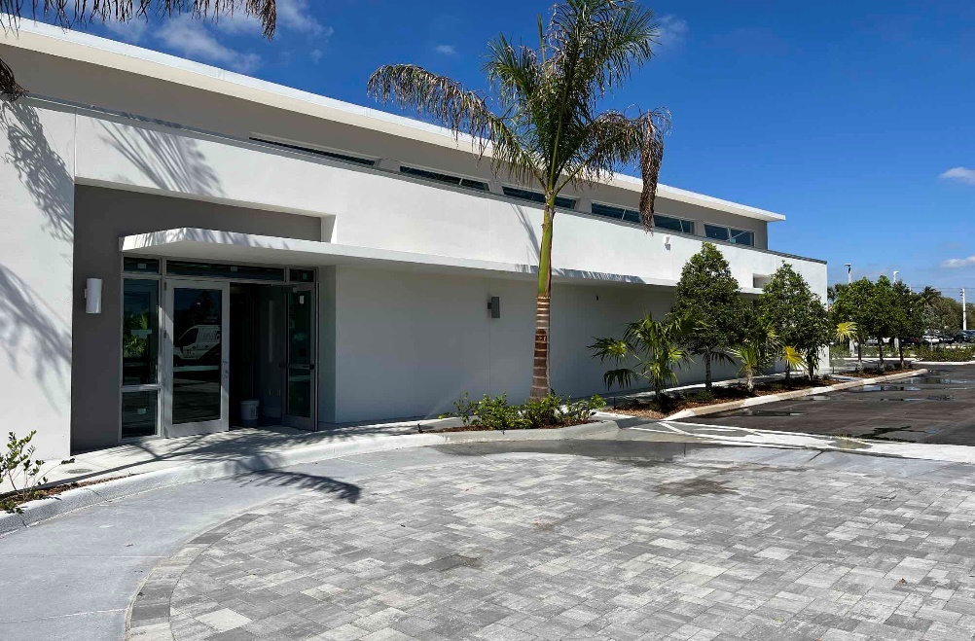
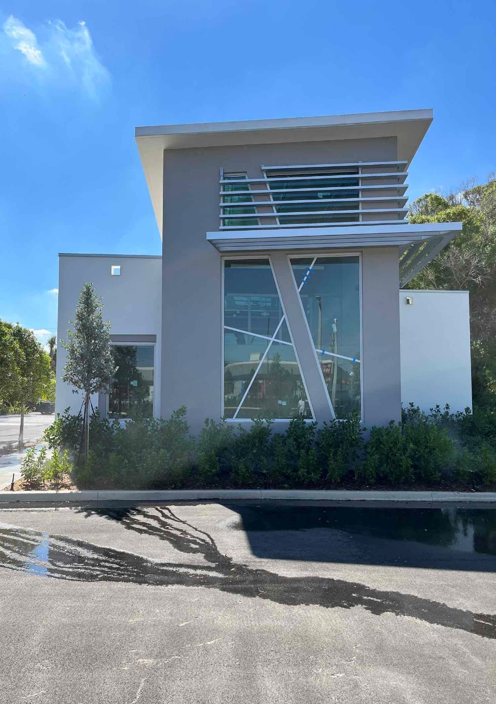
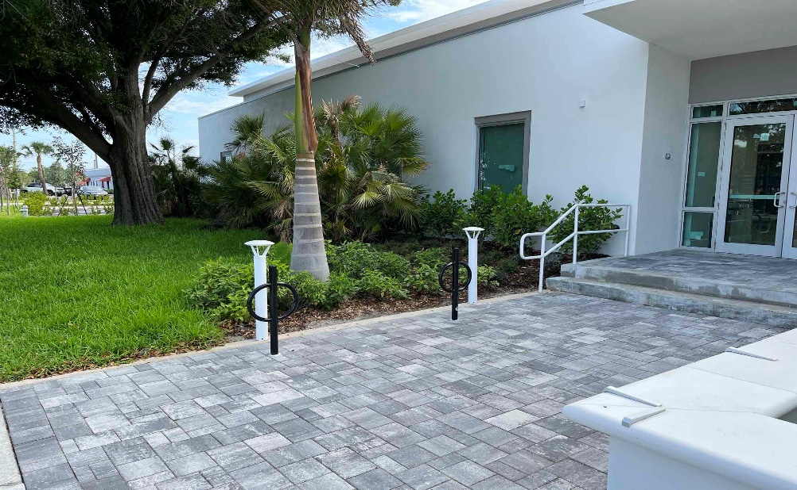
Public Facilities and Infrastructure
Construction on Eva. W. Mack Community Hub underway (CDBG)

Slide 12
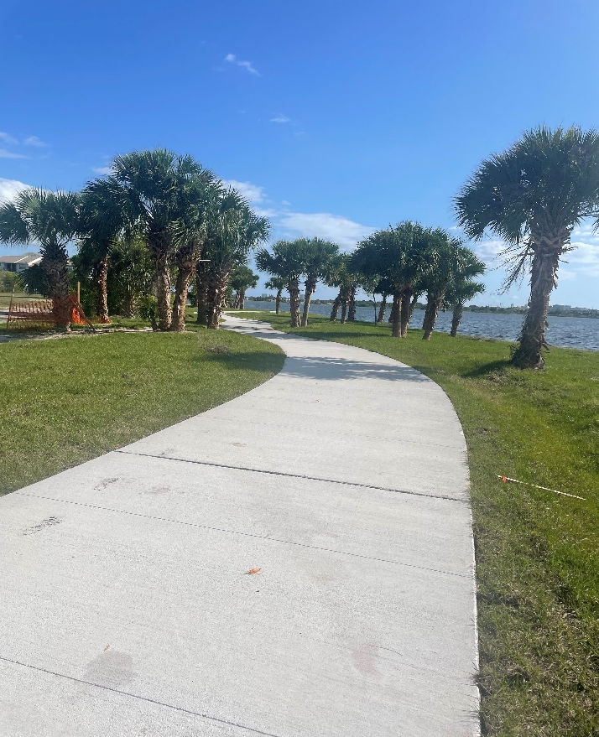
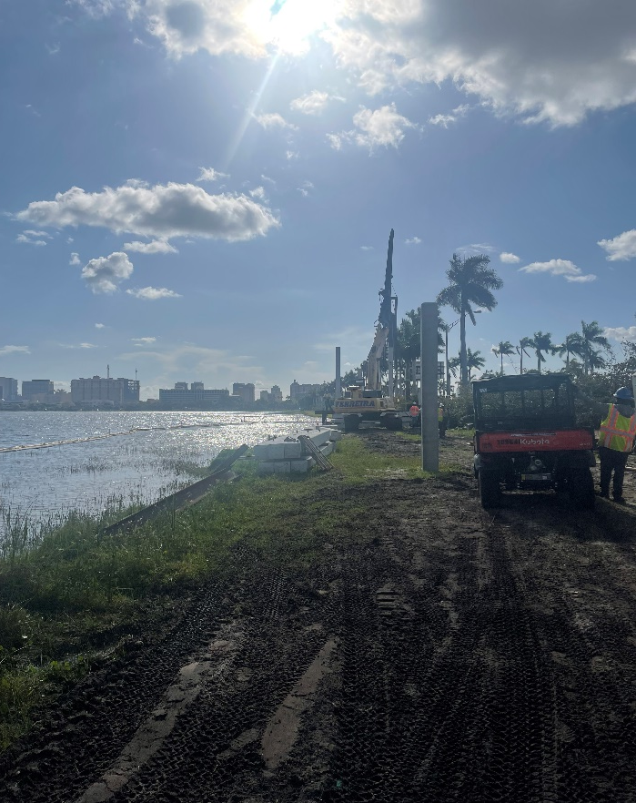
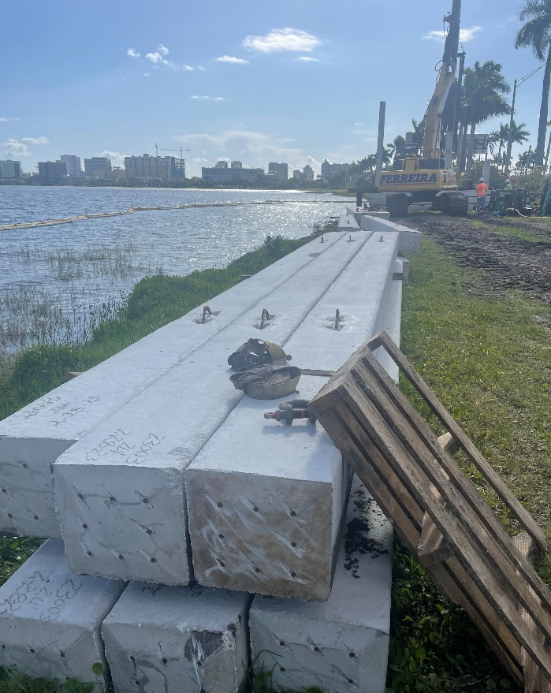
Public Facilities and Infrastructure
Clear Lake Multipurpose Trail Improvements underway (CDBG-CV)
Approximately 6,000 foot-long, 10ft wide concrete paved path and boardwalk along the western shoreline of Clear Lake. Connecting PB Lakes Blvd. to Okeechobee Blvd for increased recreational opportunities, safe and convenient bicycle, and pedestrian access.

Slide 13

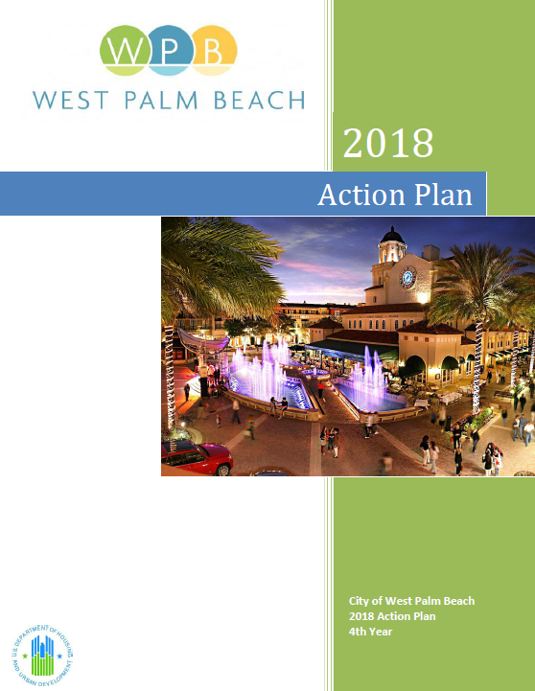
Consolidated Plan Process
FY 2023/24 Action Plan
Proposed
Activities
A Consolidated Plan (24 CFR Part 91) is the 5 year plan submitted to Housing and Urban Development (HUD) that serves as the comprehensive housing affordability strategy, community development plan, and submissions for funding under the following federal formula grant programs:
Community Development Block Grant (CDBG) Program
HOME Investments Partnership Program (HOME)
Housing Opportunities for Persons with AIDS (HOPWA) Program
The Consolidated Plan is carried out through Action Plan which provide a concise summary of the action activities, and specific federal and non-federal resources that will be used each year.
This one year action plan covers the activities that will be undertaken during the FY 21 program year October 1, 2021 – September 30, 2022.

Slide 14
2023 Action Plan – CDBG
TOTAL CDBG Entitlement Funding $ 1,011,059.00
Public Services (15%) $ 151,685.00
Public Facilities and Improvements $ 657,163.00
Planning and Administration (20%) $ 202,211.00

Slide 15
2023 Action Plan – HOME
TOTAL HOME Entitlement Funding $ 532,518.00
New Construction/Housing Development $ 399,390.00
Community Housing Development Organization
(CHDO) Set-Aside (15%) $ 79,877.00
HOME Program Administration (10%) $ 53,251.00

Slide 16
2023 Action Plan – HOPWA
TOTAL HOPWA Funding $3,552,143.00
Tenant-Based Rental Assistance $2,926,485.00
Supportive Services $90,000.00
Project Sponsor Administration $135,000.00
Grantee Program Administration (3%) $106,564.00

Slide 17
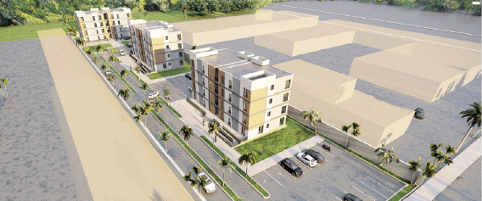
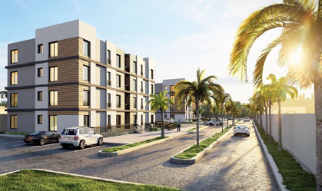
Proposed Substantial Amendment
Reallocate HOME and HOPWA funds in previous Annual Action Plans to fund eligible housing activities
Grant Year | HUD Program | Funding Amount
2017 | HOME | $ 210,143.62
2018 | HOME | $ 32,688.25
2019 | HOME | $ 162,163.35
2020 | HOME | $ 280,182.90
2022 | HOPWA | $ 564,821.88
 | TOTAL | $1,250,000.00
Legacy at 45th Street

Slide 18
What’s Ahead for the Action Plan
7/10/2023
City Commission Approval of FY 2023 Action Plan
8/16/2023
Action Plan due to HUD
8/16/2023- 9/30/2023 HUD Approval
10/1/2023 First day of Fiscal Year 2023-2024
6/10/2023 – 7/10/2023
30-day comment period

Slide 19
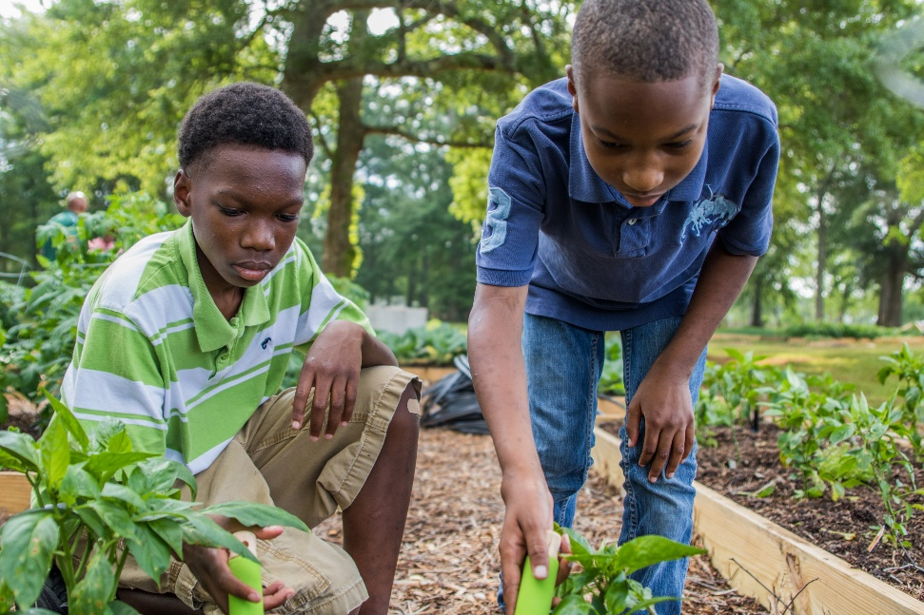
Other HCD Happenings
WPB/FAMU Partnership
Cooperative Extension Program:
Sustainable Farming
Education
Job Training
Affordable produce available for local consumption
3 community gardens at the following locations:
  Coleman Park Community Center
  Pleasant City – Gloria Y. Williams Multicultural Center
  Phipps Park

Slide 20
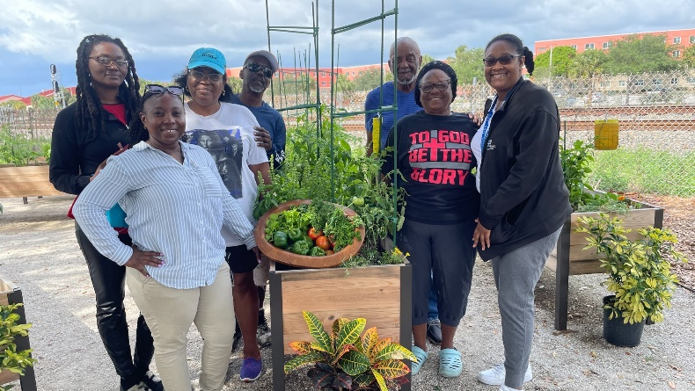
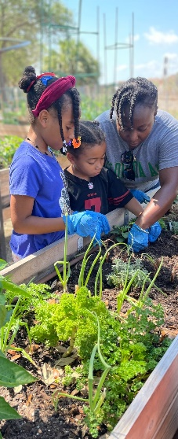
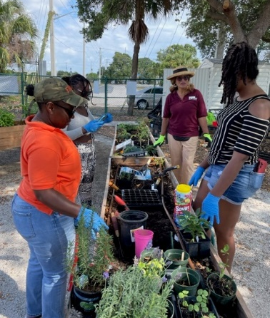
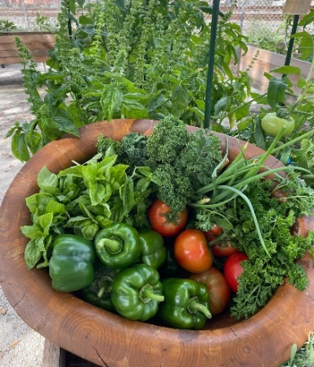
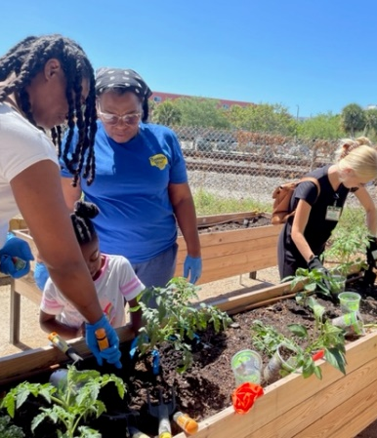
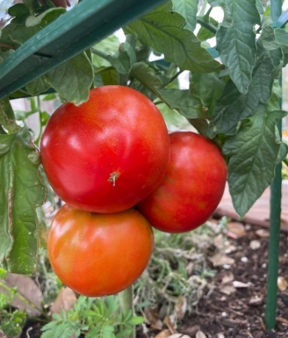
Coleman Park Community Garden

Slide 21
Questions or Comments from the Public

Slide 22
Any other comments and/or questions, please contact:
Kimberly Spence
HCD Programs Manager
ksspence@wpb.org
561-822-1250
http://wpb.org/housing

